Slide 1
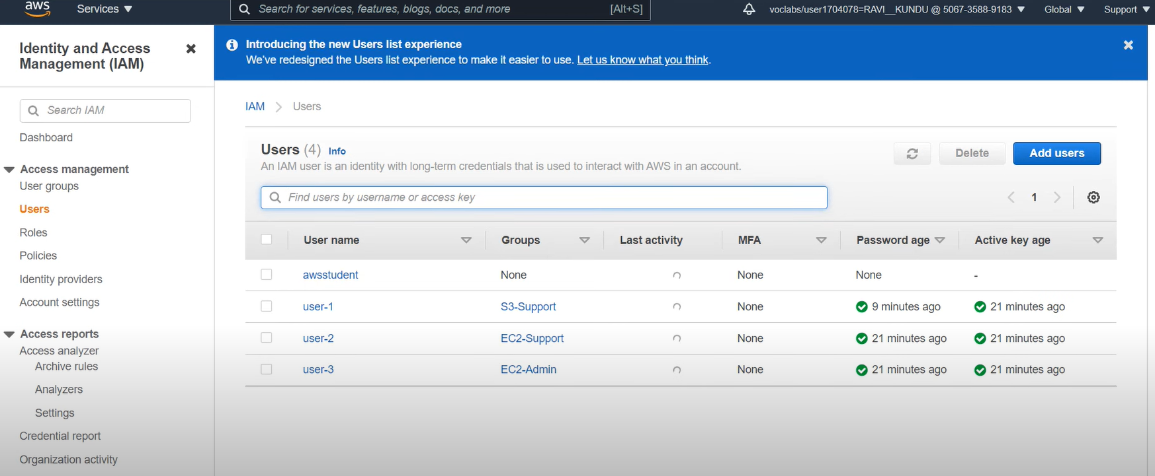
Lab 1: Introduction to AWS IAM
Task 1: Explore the Users and Groups

Slide 3
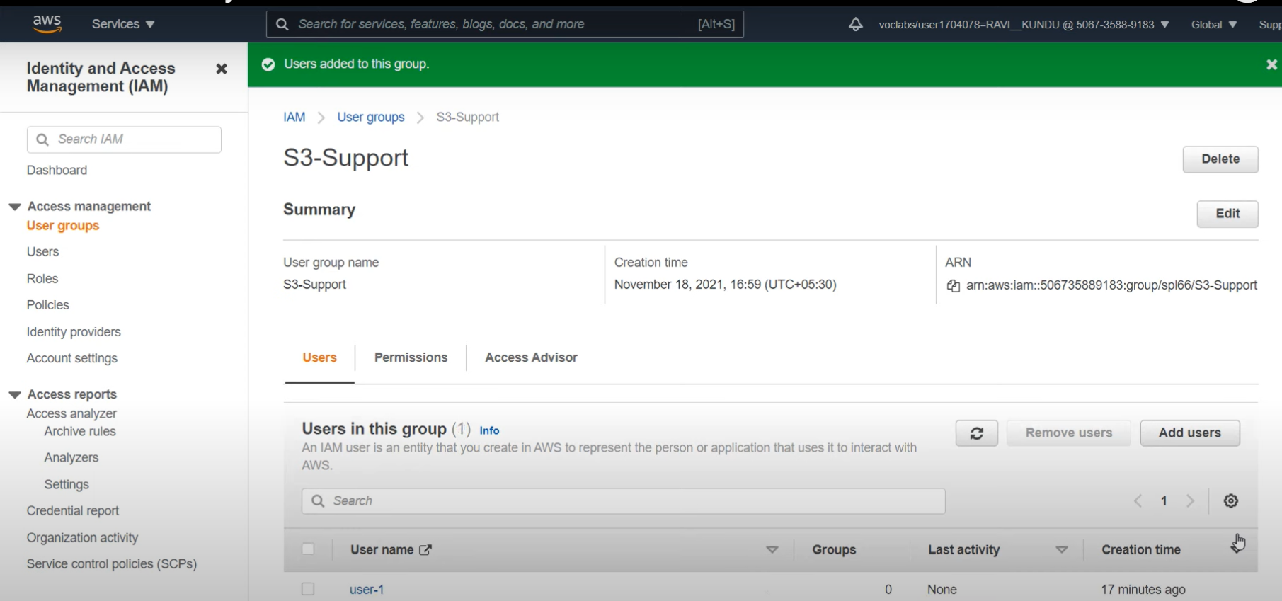
Task 2: Add Users to Groups
Add user-1 to the S3-Support Group
Add user-2 to the EC2-Support Group
Add user-3 to the EC2-Admin Group
Add user-2 to the EC2-Support Group
Add user-3 to the EC2-Admin Group

Slide 4
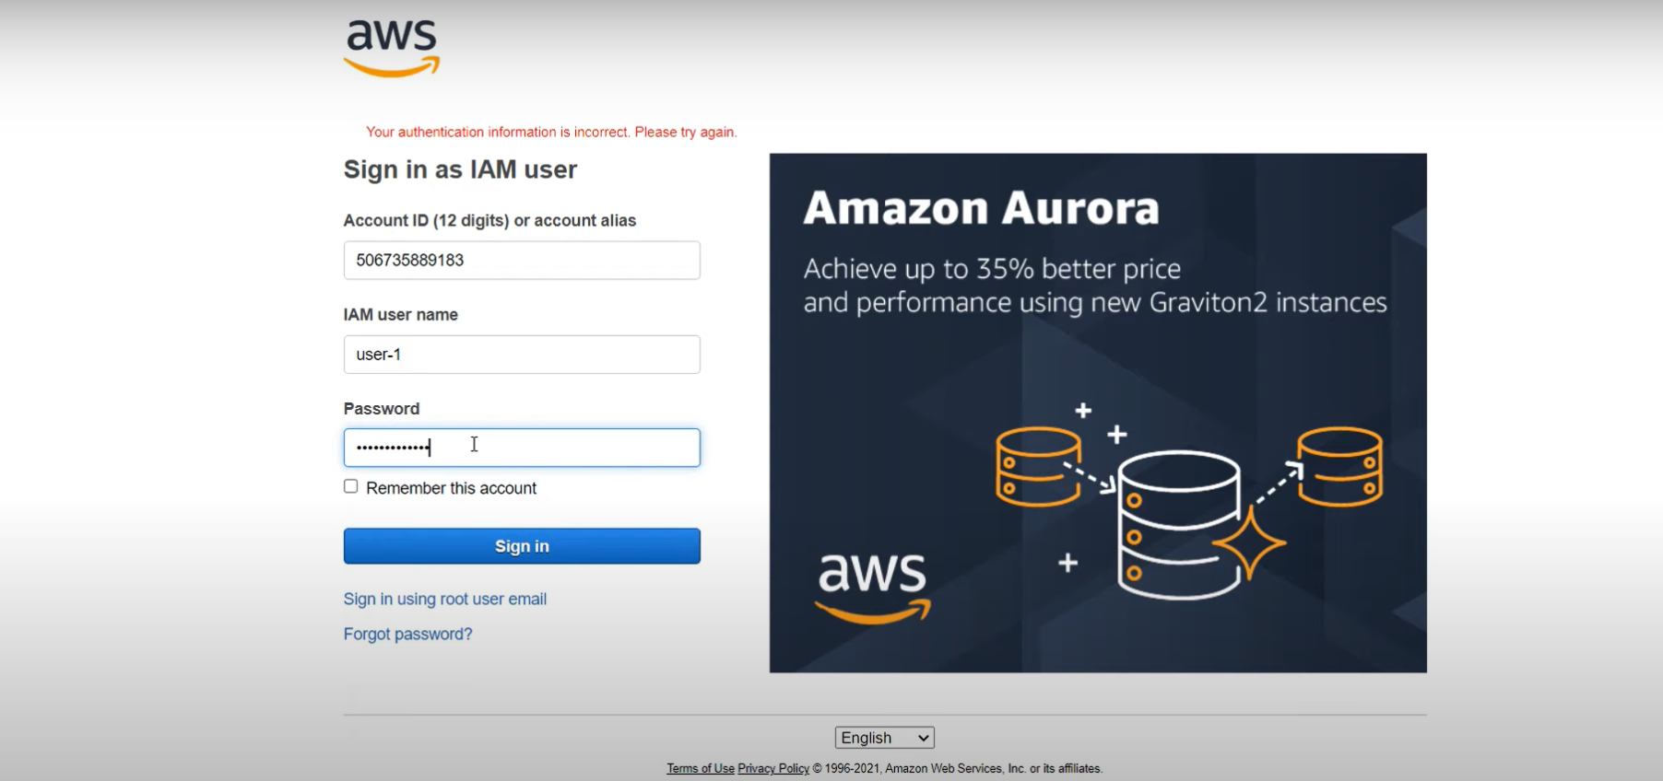
Task 3: Sign-In and Test Users

Slide 5
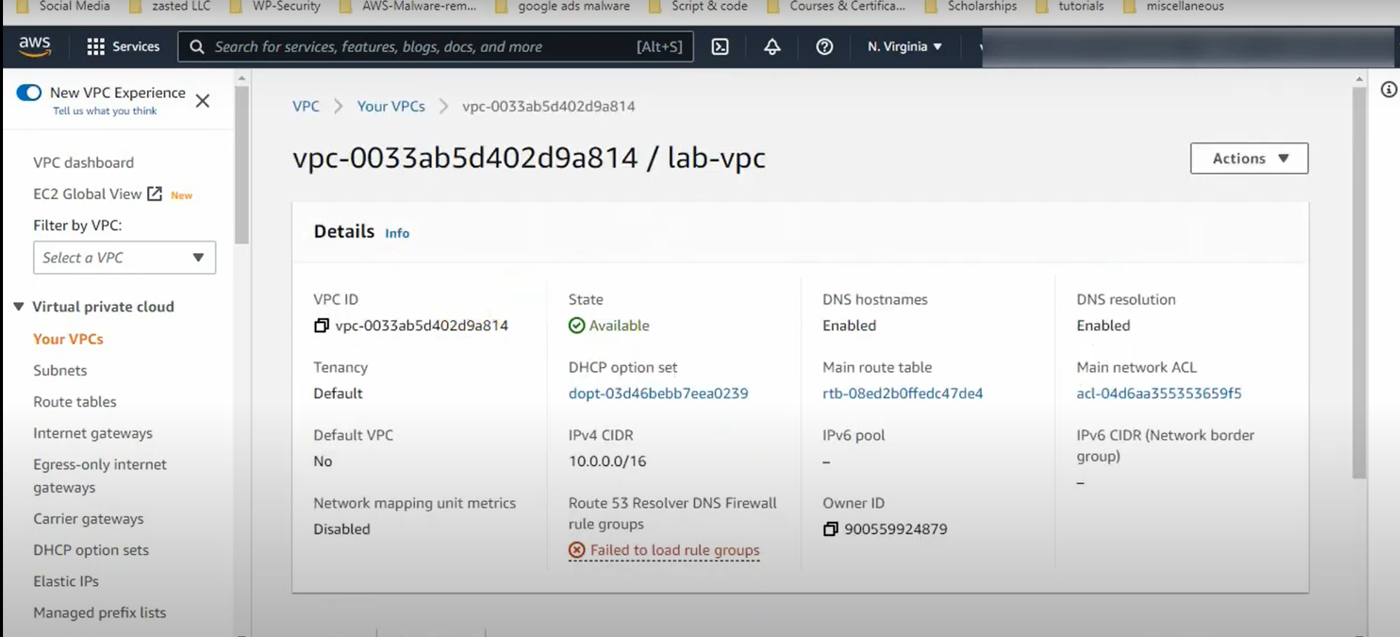
Lab 2: Build your VPC and Launch a Web Server
Task 1: Create Your VPC

Slide 6
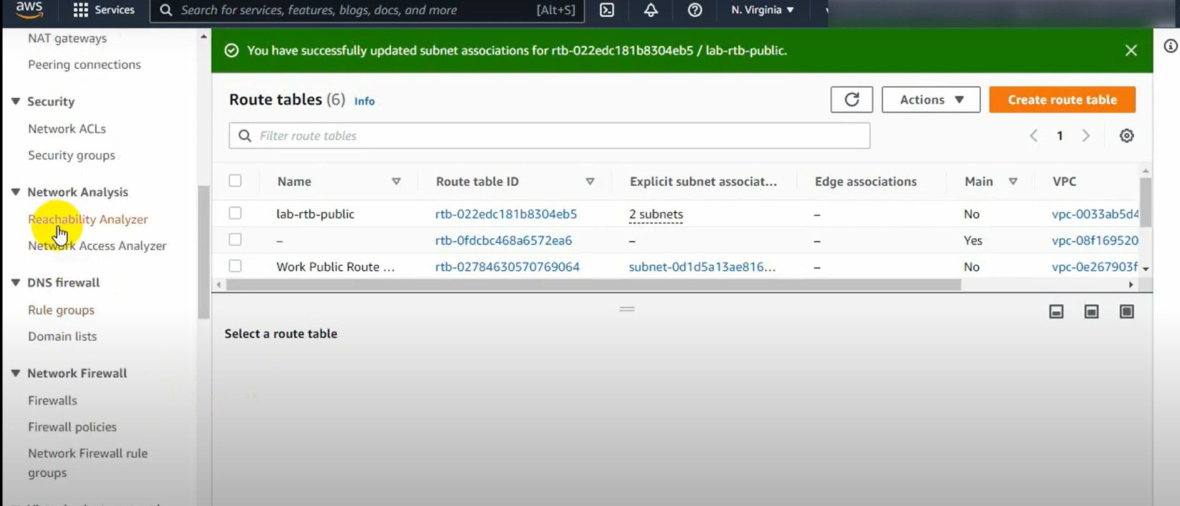
Task 2: Create Additional Subnets

Slide 7
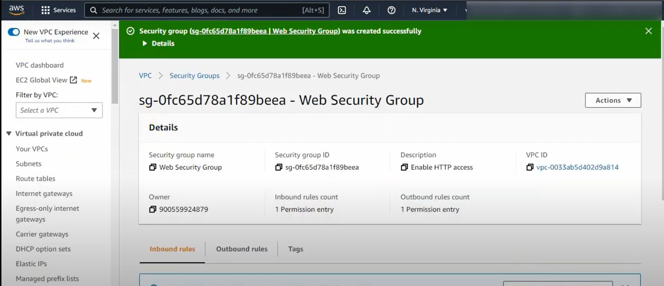
Task 3: Create a VPC Security Group

Slide 8
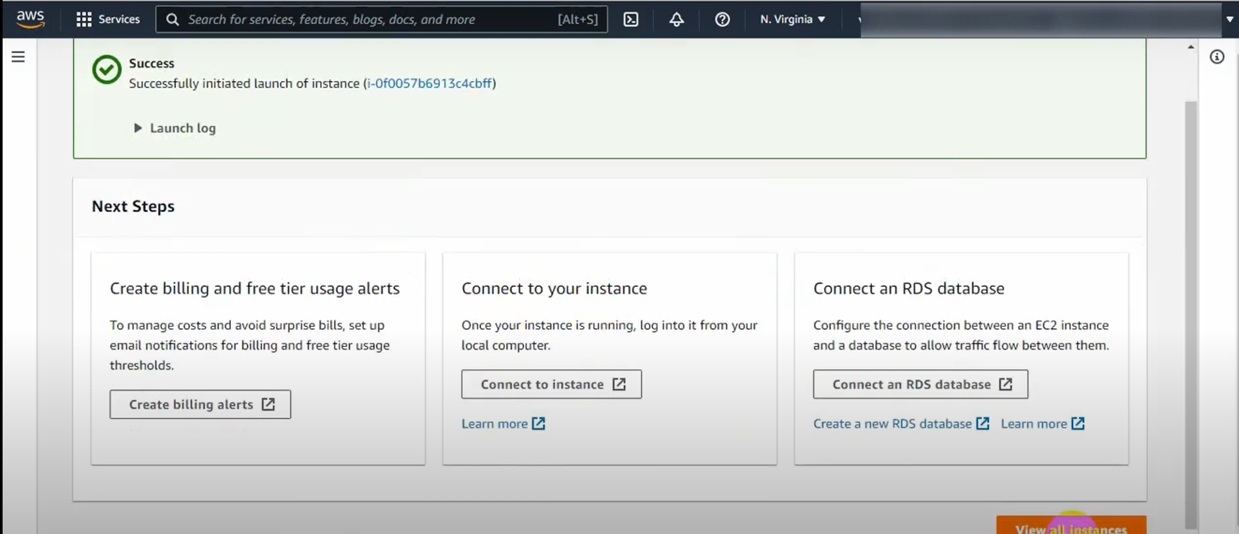
Task 4: Launch a Web Server Instance

Slide 9
Lab 3: Introduction to Amazon EC2
Task 1: Launch Your Amazon EC2 Instance
Step 1: Name and tags
Step 2: Application and OS Images (Amazon Machine Image)
Step 3: Instance type
Step 4: Key pair (login)
Step 5: Network settings

Slide 10
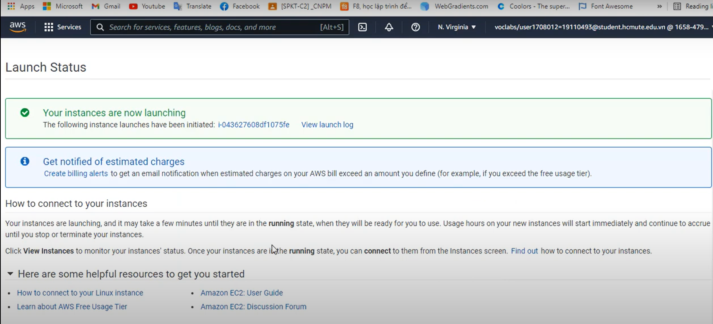
Step 6: Configure storage
Step 7: Advanced details
Step 8: Launch the instance

Slide 11
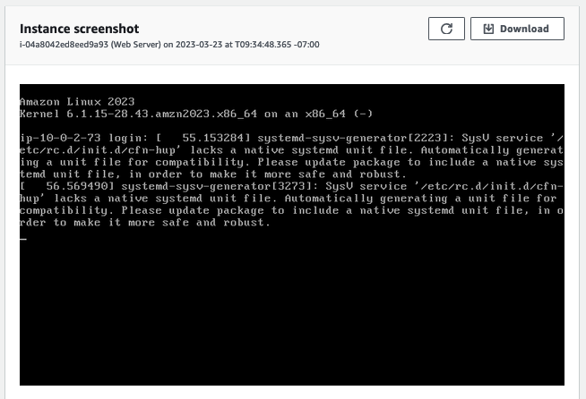
Task 2: Monitor Your Instance

Slide 12
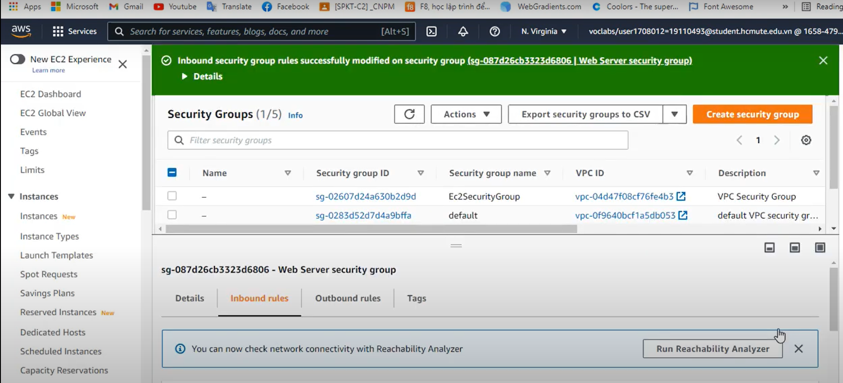
Task 3: Update Your Security Group and Access the Web Server

Slide 13
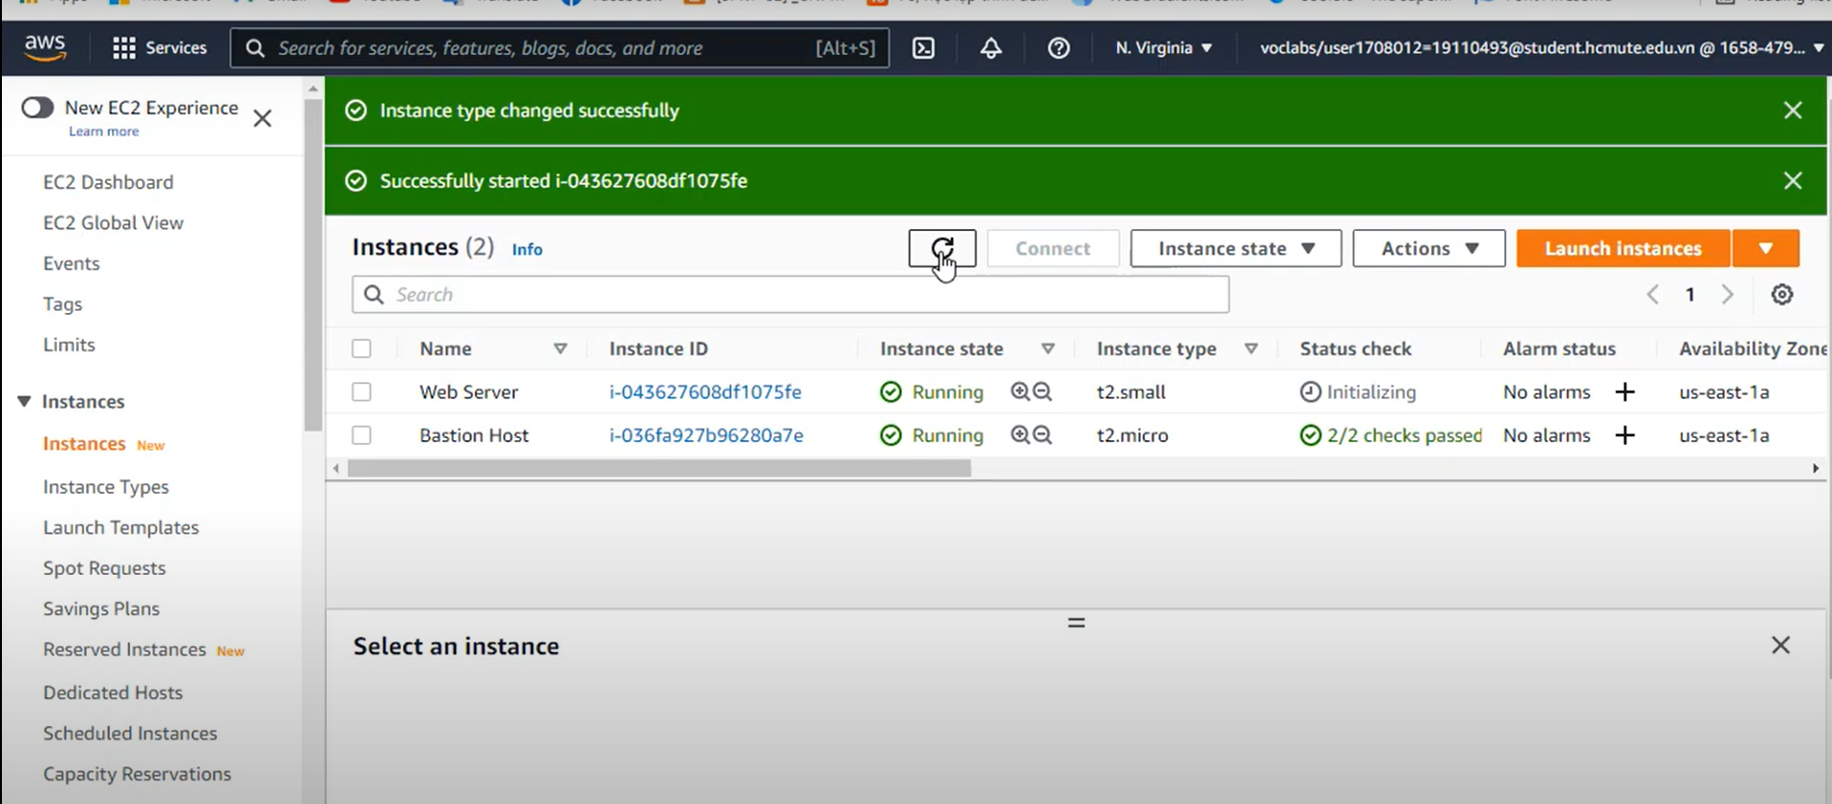
Task 4: Resize Your Instance: Instance Type and EBS Volume

Slide 14
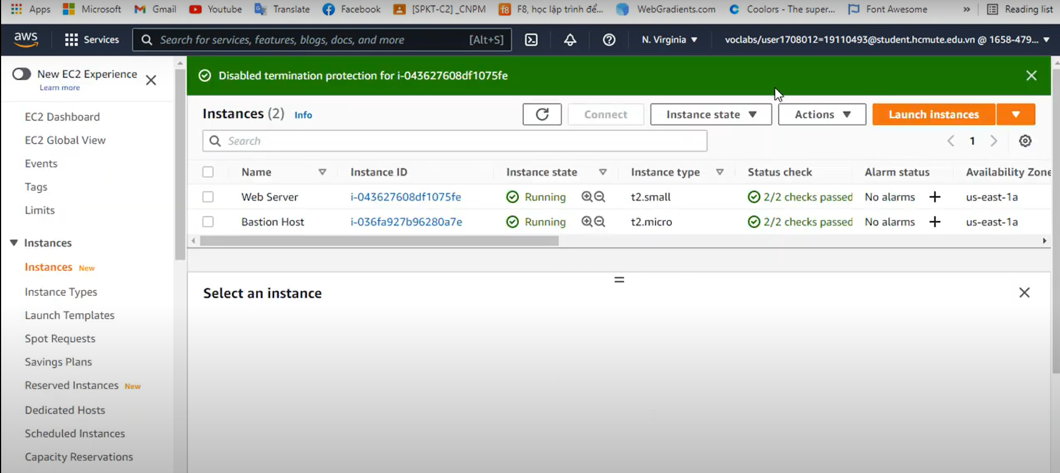
Task 5: Explore EC2 Limits

Slide 15
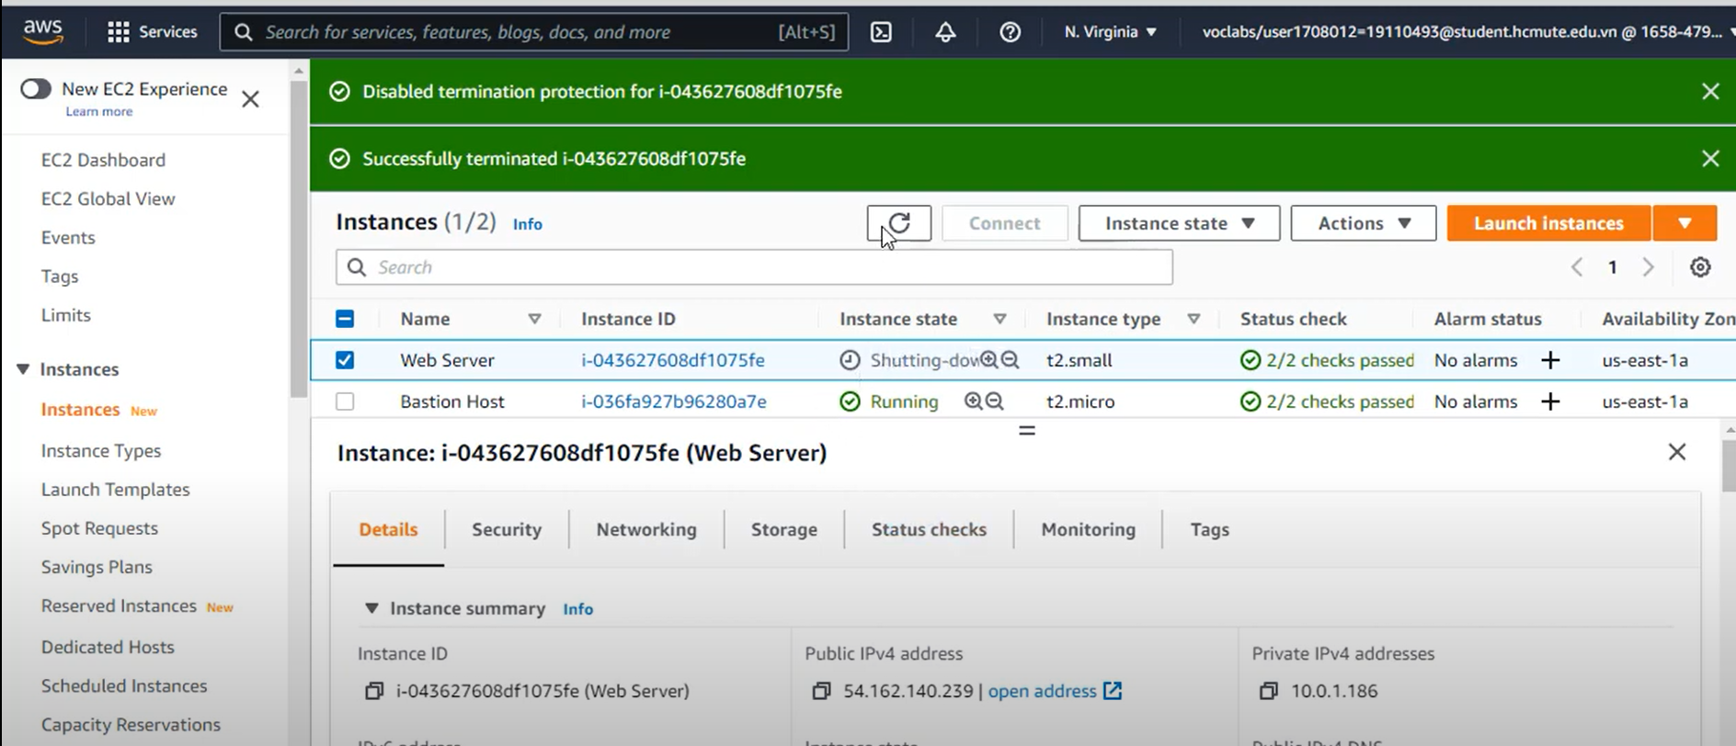
Task 6: Test Termination Protection

Slide 16
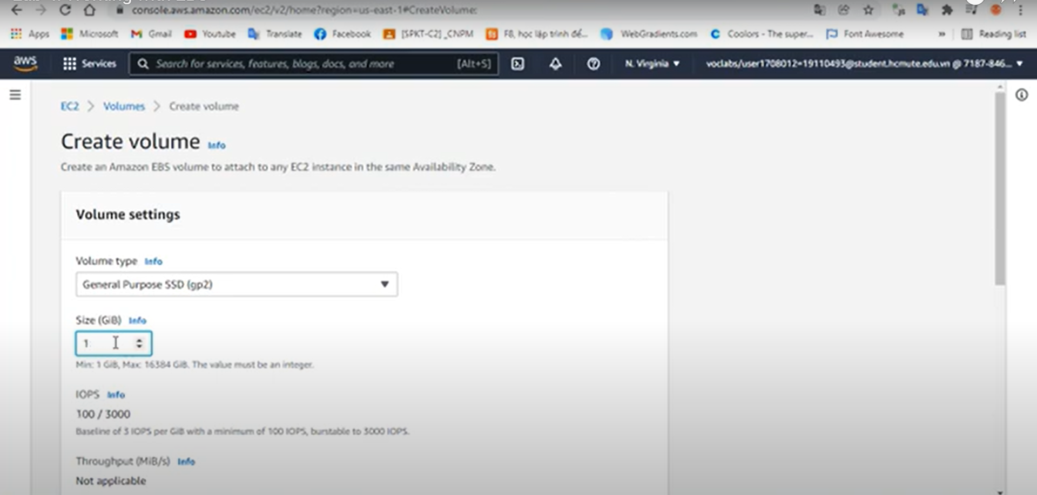
Lab4:Working with EBS
Create a New EBS Volume
Attach the Volume to an Instance
Connect to Your Amazon EC2 Instance
Create and Configure Your File System
Create an Amazon EBS Snapshot
Restore the Amazon EBS Snapshot
Attach the Restored Volume to Your EC2 Instance
Restore the Amazon EBS Snapshot
Attach the Restored Volume to Your EC2 Instance
Mount the Restored Volume

Slide 17
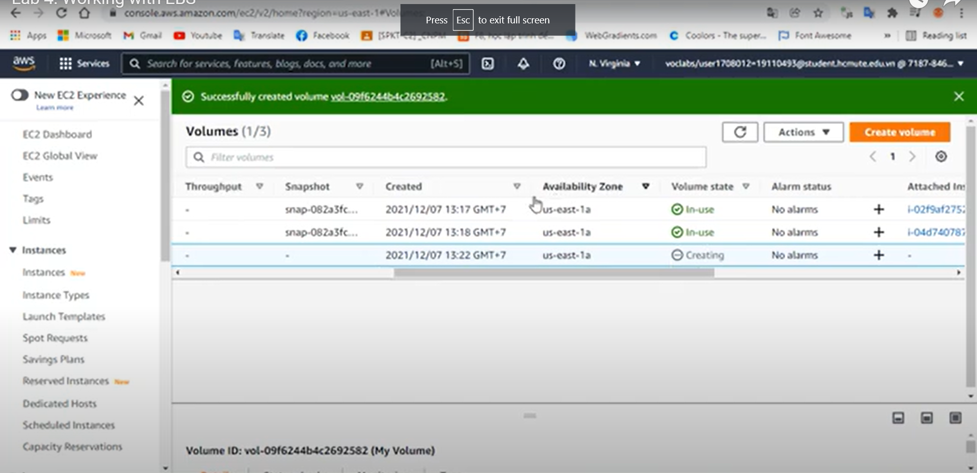
Attach the Volume to an Instance

Slide 18
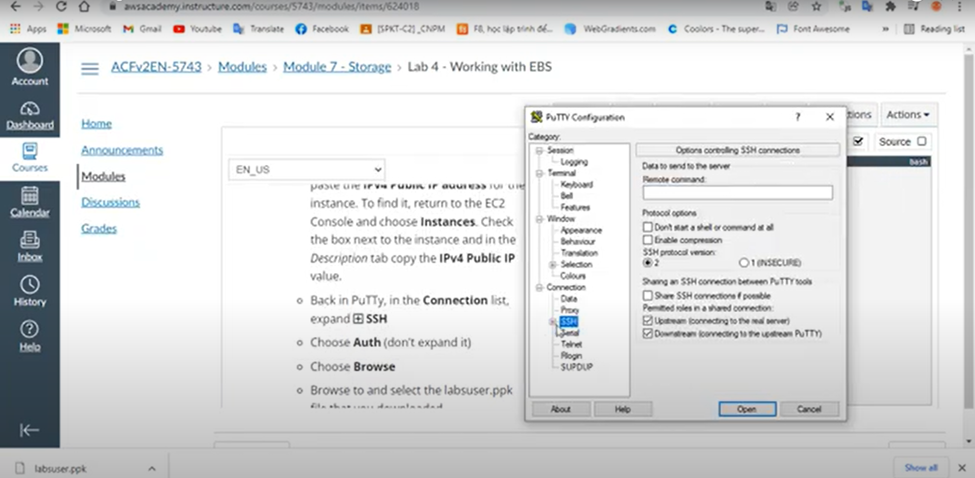
Connect to Your Amazon EC2 Instance

Slide 19
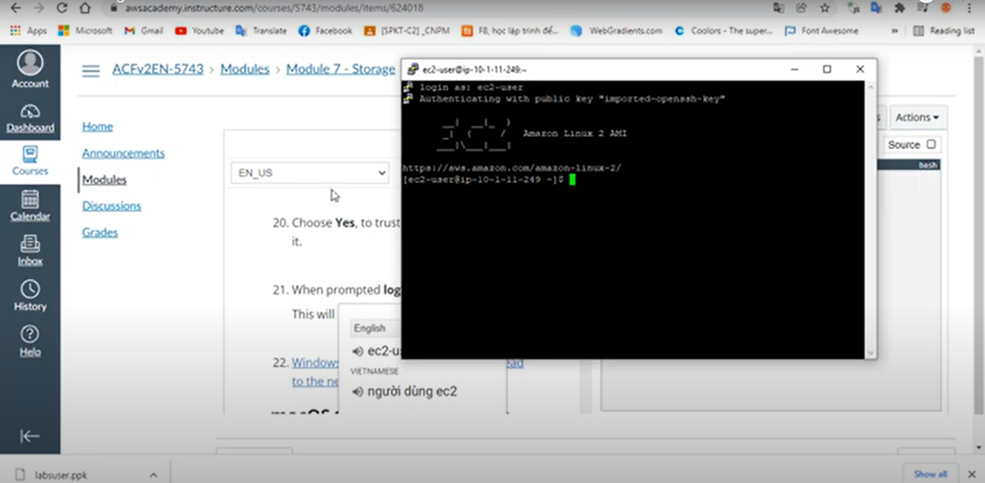
Create and Configure Your File System

Slide 20
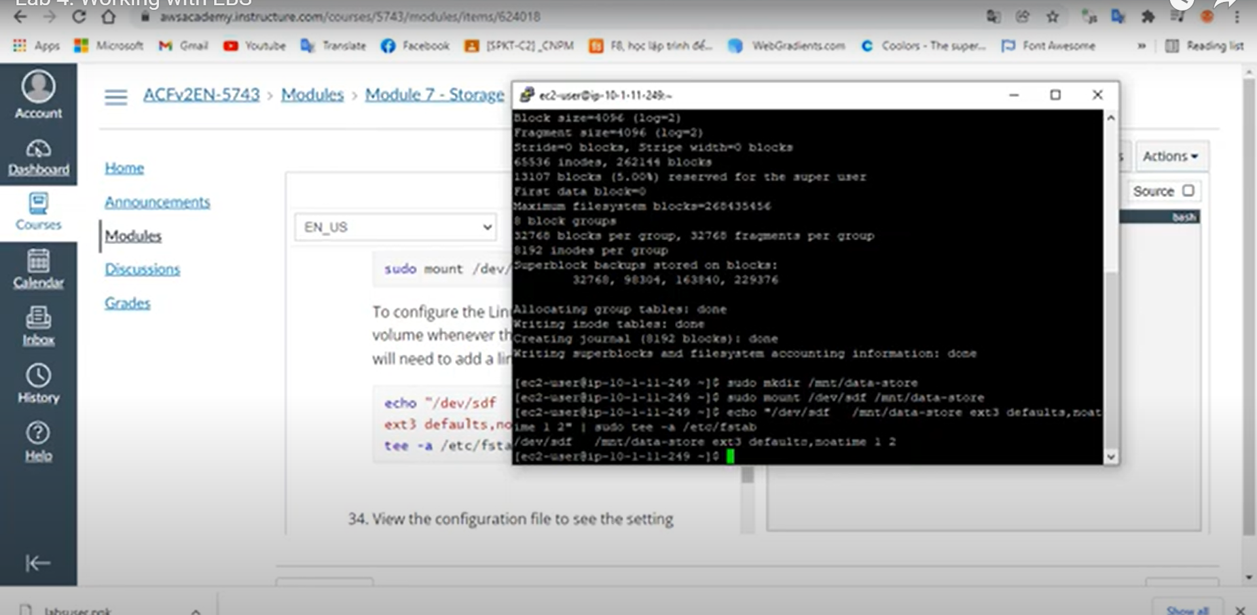
Create an Amazon EBS Snapshot

Slide 21
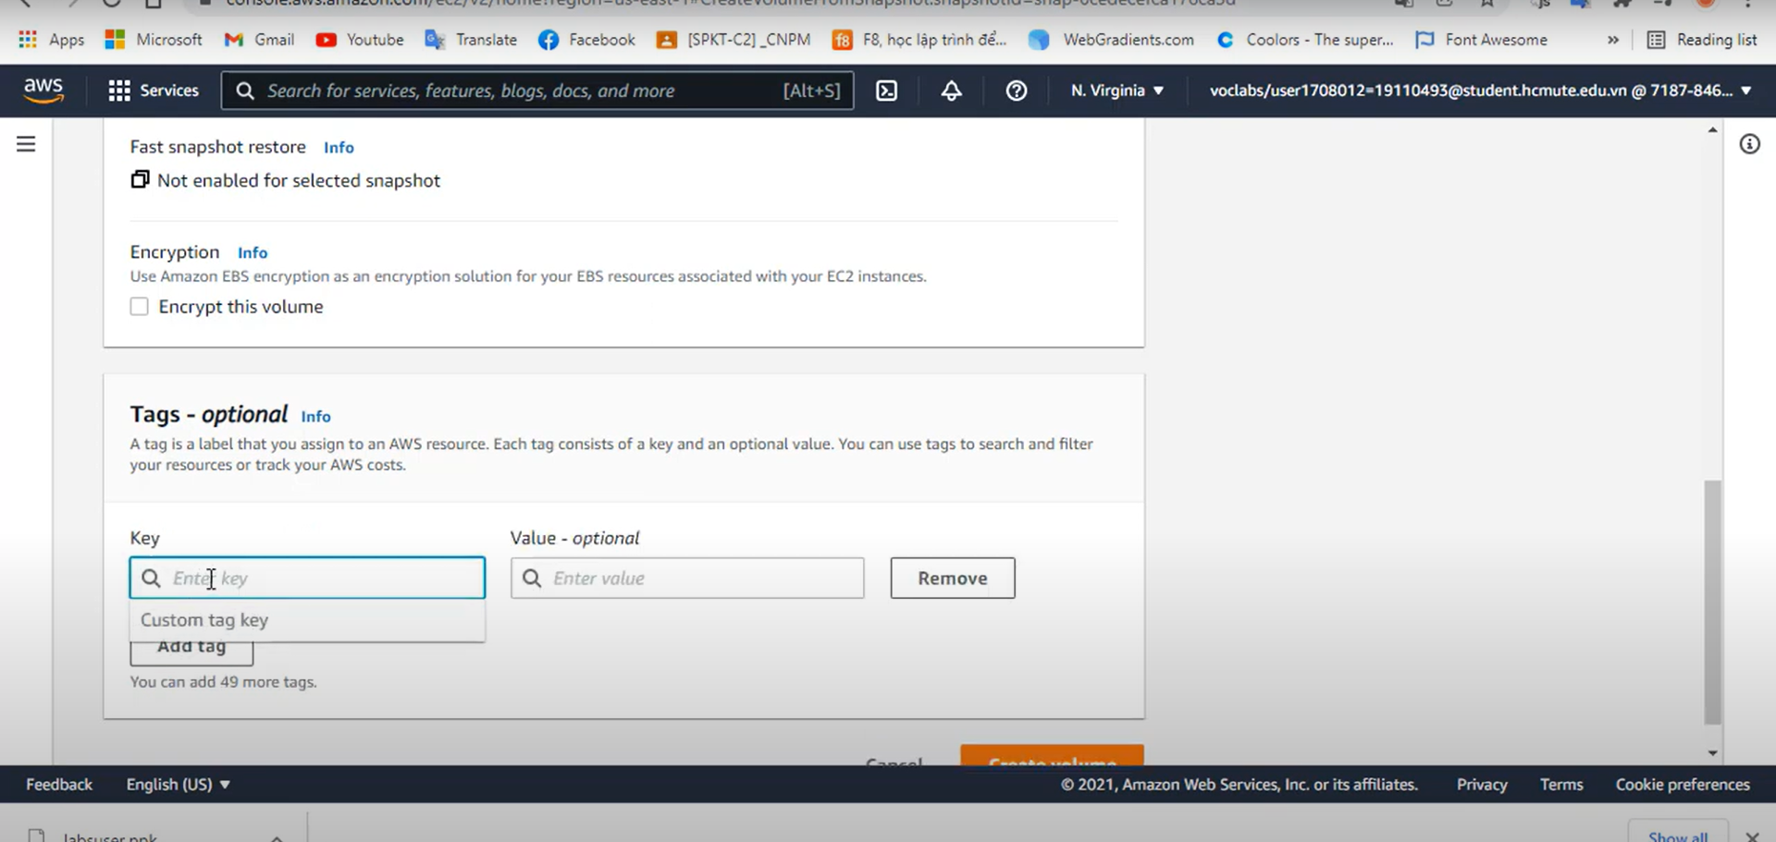
Restore the Amazon EBS Snapshot

Slide 22
Create an Amazon EBS Snapshot
Restore the Amazon EBS Snapshot
Attach the Restored Volume to Your EC2 Instance
Mount the Restored Volume

Slide 23
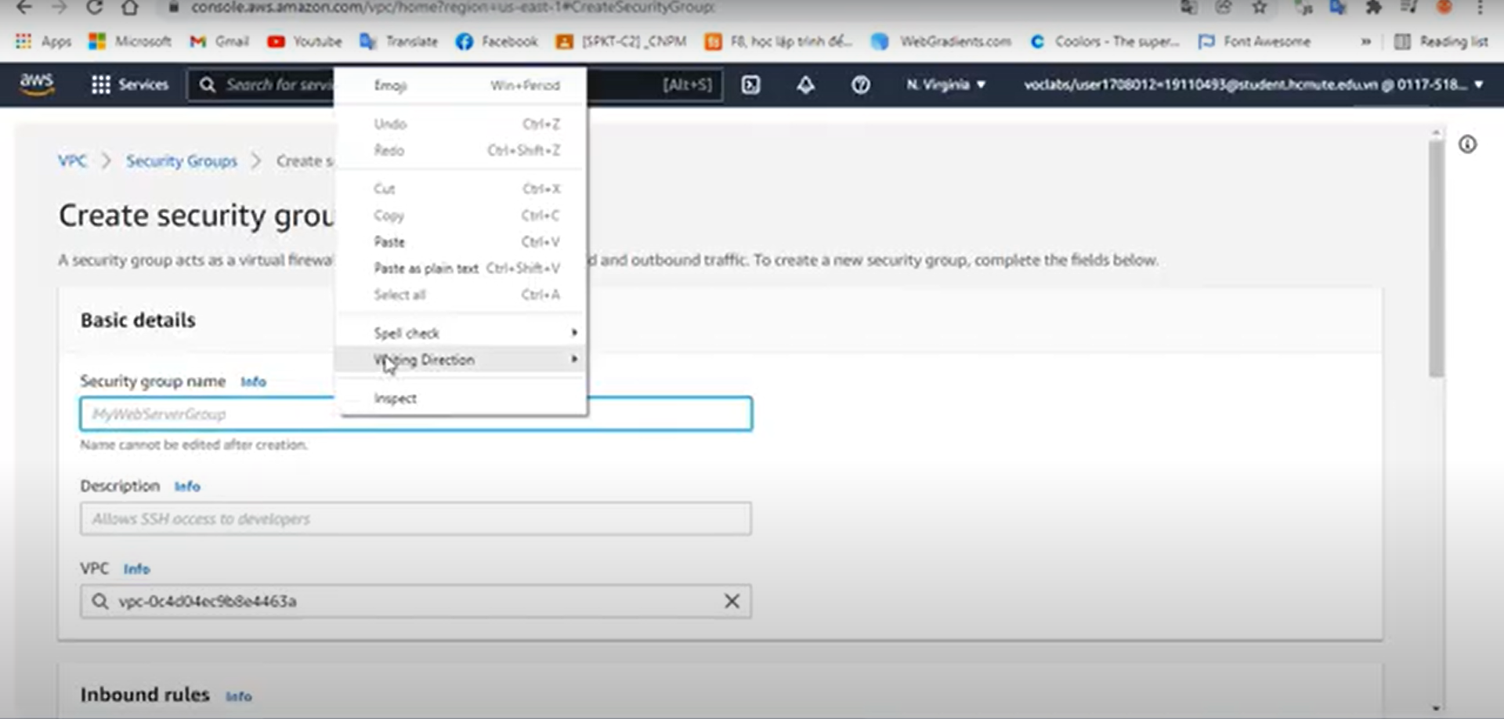
Build Your DB Server and Interact With Your DB Using an App
Create a Security Group for the RDS DB Instance

Slide 24
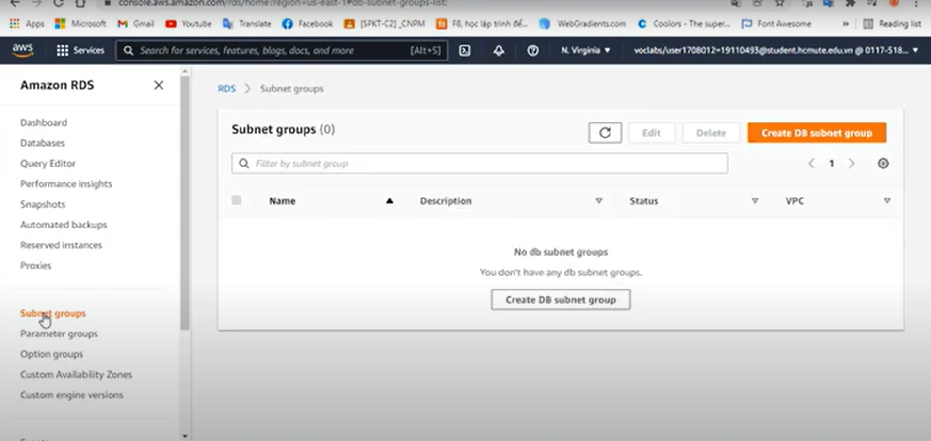
Create a DB Subnet Group

Slide 25
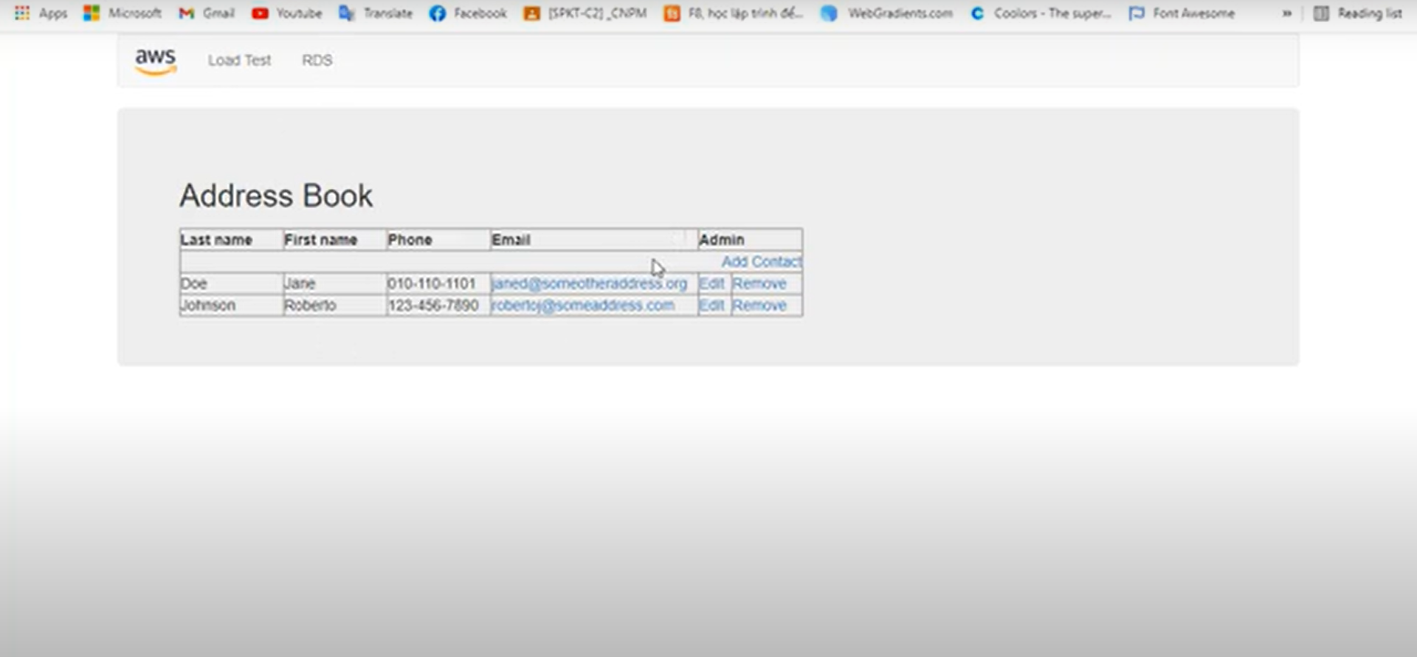
Create an Amazon RDS DB Instance
Interact with Your Database

Slide 26
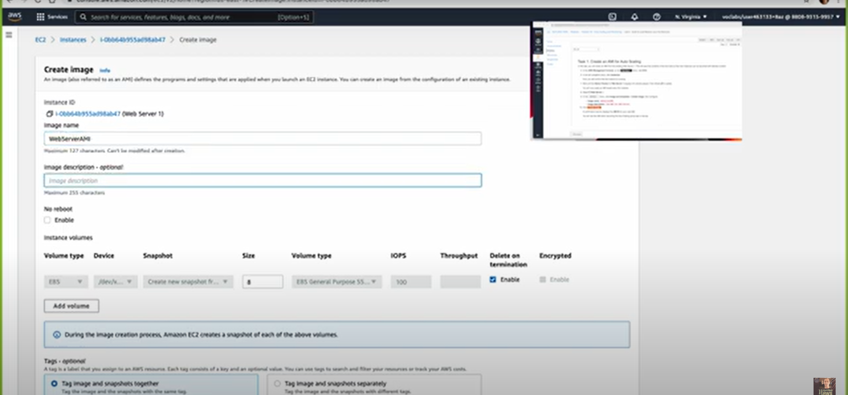
Scale and Load Balance Your Architecture
Create an AMI for Auto Scaling

Slide 27
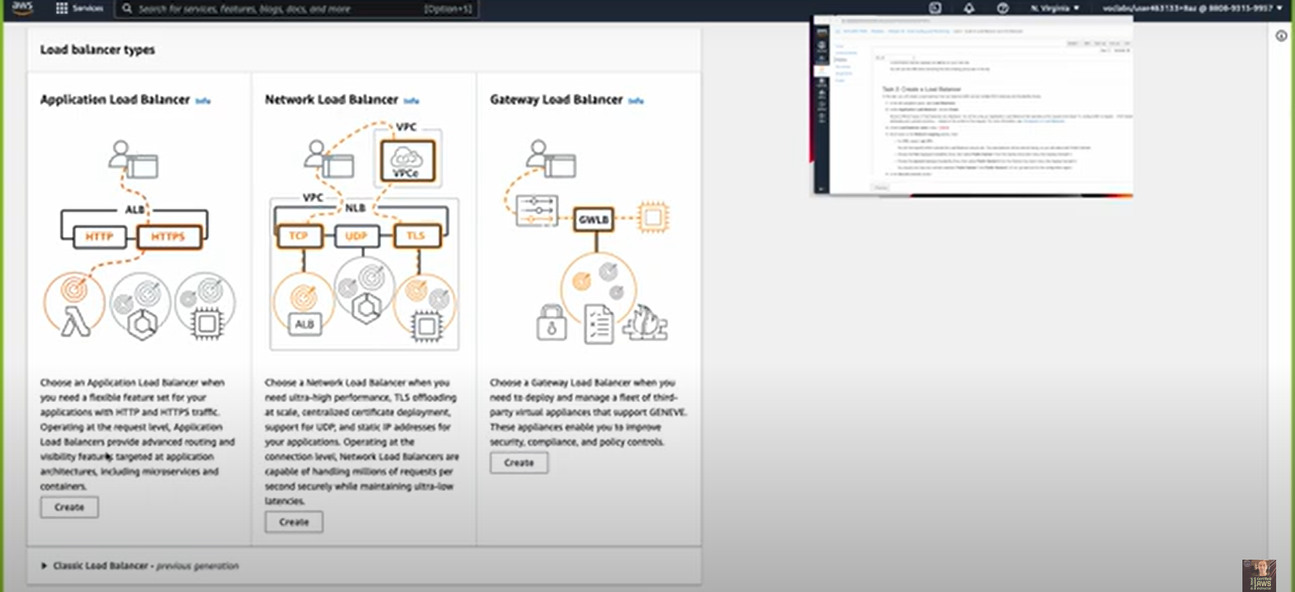
Create a Load Balancer

Slide 28
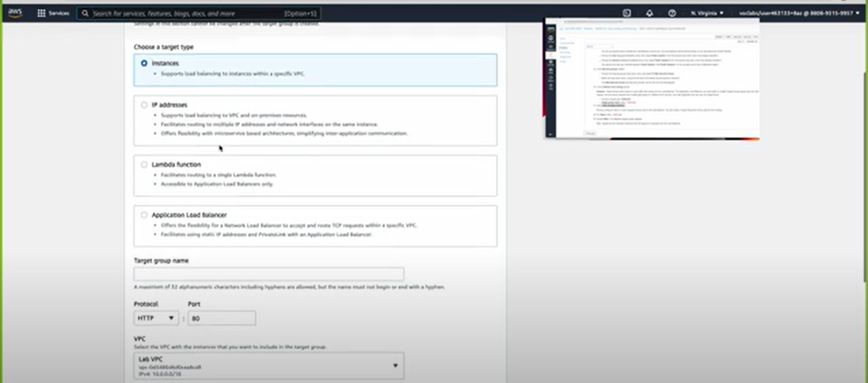
Create a Launch Configuration and an Auto Scaling Group

Slide 29
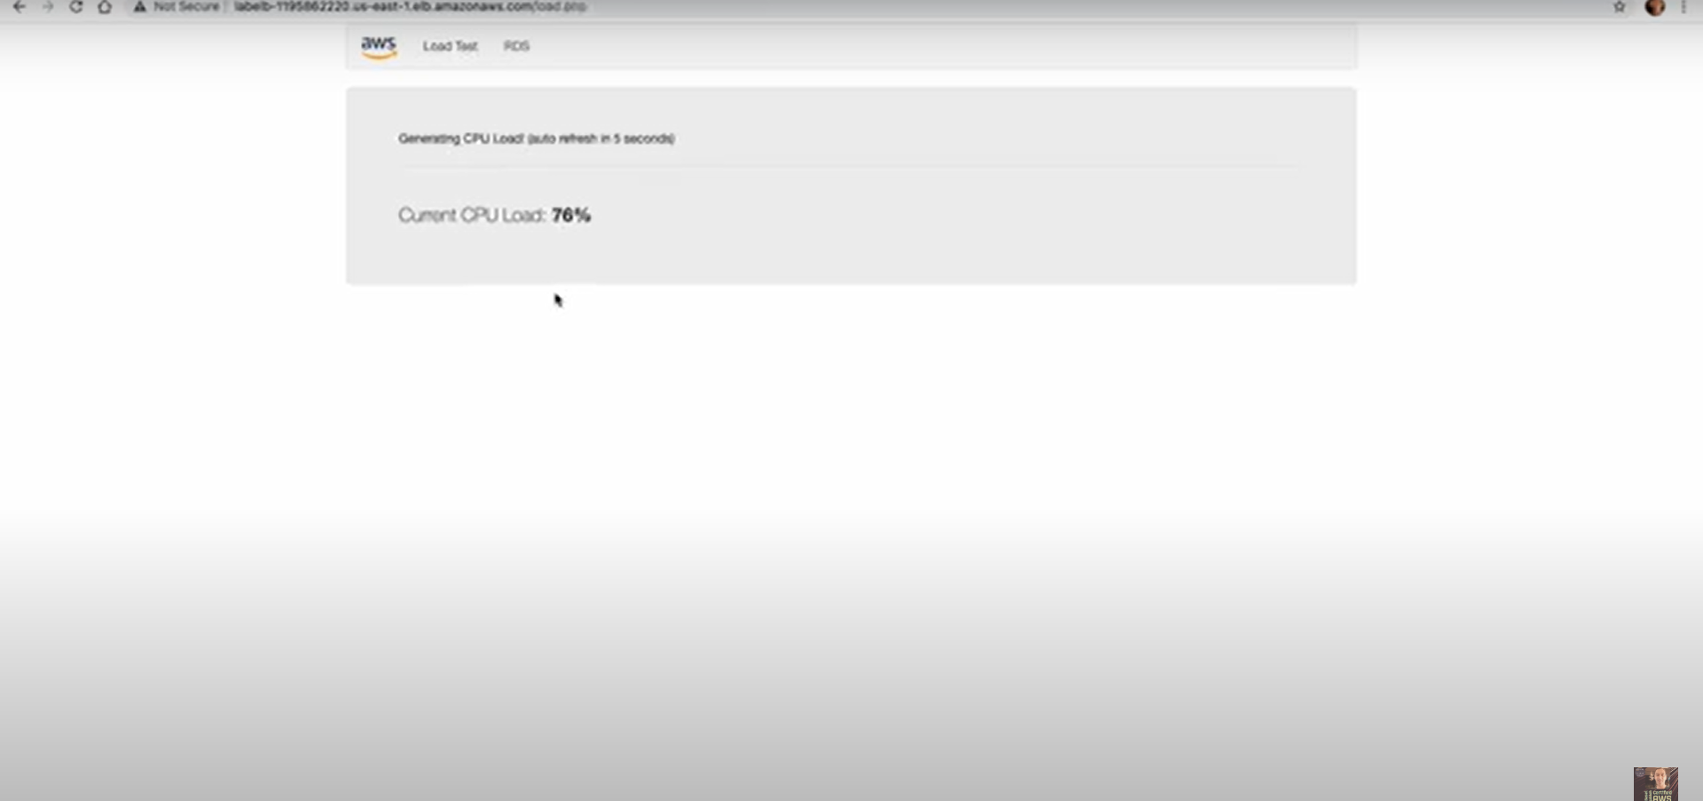
Verify that Load Balancing is Working
Test Auto Scaling

Slide 30
Terminate Web Server 1

